Slide 1
S20-65 Capstone Design: Music Sheet Maker
Sifan Yuan(sy609)
Haocong Wang(mw814)
Advisor: Prof. Yingying Chen
Instructor: Ph.D. Yilin Yang

Slide 2
Scope of Work
Audio data fetching and preprocessing (Checked)
Music Transcription (Simple Piano Music) (In progress)
- Create MIDI file based on the audio
Write it into music sheet (Checked)
Improve the system *

Slide 3
Progress and Future Plan
Task Name | Progress (%) | Estimated Completion Date
Extract the audio data | 100%
Analyze the data in the frequency domain | 100% | 2020.03.22
Label the data by pitch | 100% | 2020.03.22
Divide the data into a single note | 100%
Create the MIDI file | 50% | 2020.03.31
Deal with the noise | 30% | 2020.04.05
Apply the UI | 10% | 2020.04.16

Slide 4
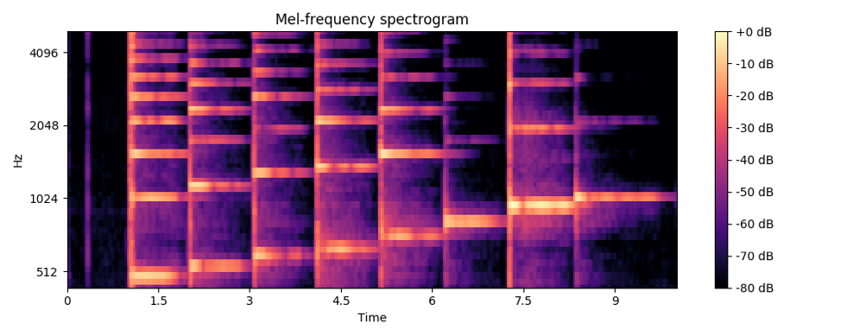
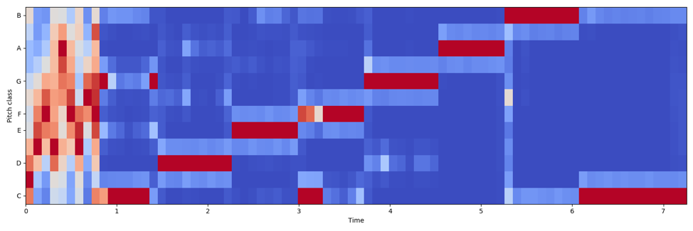
Progress and Challenge
Collect the data of one single octave and use it as the sample
We worked on the data analyzing part of the plan. To change the data into a time-frequency domain, we use the algorithm of spectrogram and chroma gram to process the audio we get before.

Slide 5
Spectrogram & Chromagram
Spectrogram is a kind of algorithm that we use to analyze the audio signal. A spectrogram is a visual representation of the spectrum of frequencies of a signal as it varies with time. When applied to an audio signal, spectrograms are sometimes called sonographs, voiceprints, or voicegrams.
In music, the term chroma feature or chromagram closely relates to the twelve different pitch classes. Chroma-based features, which are also referred to as "pitch class profiles", are a powerful tool for analyzing music whose pitches can be meaningfully categorized (often into twelve categories) and whose tuning approximates to the equal-tempered scale.

Slide 6
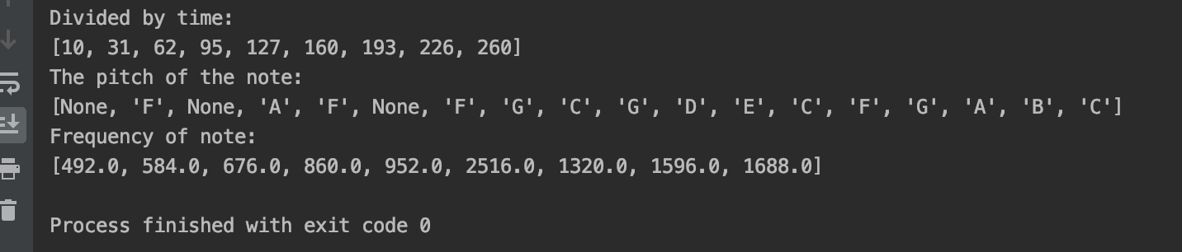
Progress and Challenge
By using these two kinds of data, we successfully divide the audio by every single note and also can label the note by different pitch.

Slide 7
Progress and Challenge
But as the spectrogram shows, the frequency of a single pitch will reflect on different frequency bands. So, it is difficult to determine which octave (from a lower do to a higher do) does the pitch in. This also can’t be solved by the chroma gram too. Chroma gram can get the exactly pitch of different frequency, but it can’t figure out which octave does this pitch in.

Slide 8
Progress and Challenge
To solve the problem of the exact octave determination, we want to compare the strength of the pitch in different frequency bands to get the highest one to be the target.
But, sometimes the maximum of the strength of frequency may be wrong somewhere, so we need to compare more detail data to get the result.

Slide 9
Progress and Challenge
We use the sliding window to do the analyzing work. We first find out the maximum window from the part we divided before. Then, we choose the maximum column from this window so that we can get the exact detail frequency of this part of radio, in a word, we get the exact octave of this single note.
After solving this problem, we can now transcript some simple music.

Slide 10
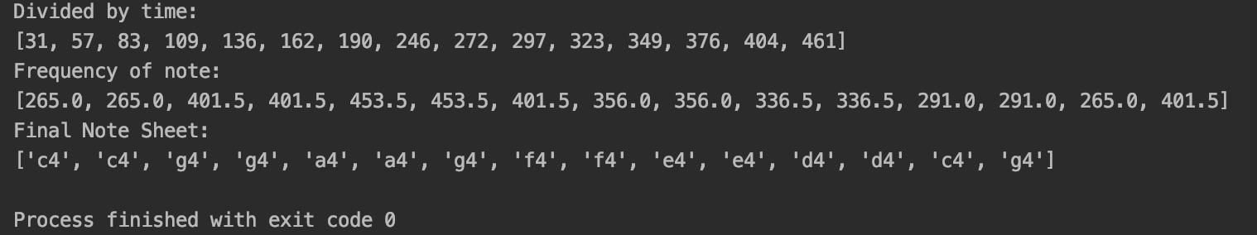
Demo

Slide 11
Thank You for Your Attention!
Sifan Yuan: sy609@scarletmail.rutgers.edu
Haocong Wang: mw814@scarletmail.rutgers.edu

